Slide 1
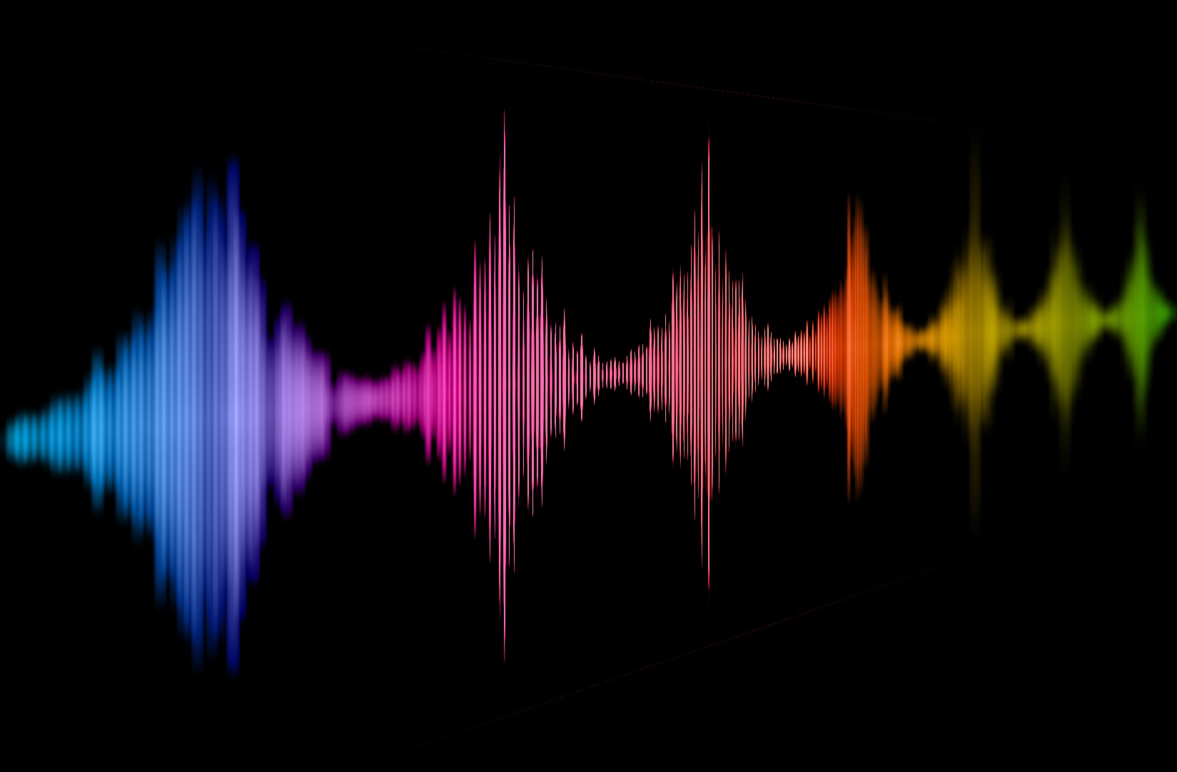
Naturalness of voices - how humans and artificial agents could learn from one another
Christine Nussbaum
Voice Research Unit, 16.02.2024
Voice Naturalness
Notes:
Provocative title
I want to tell you a story (sorry if its still a bit chaotic) and I want to convince you of my mission
Mission: naturalness is something we talk about -> we should strive for a systematic understanding (pooling insight from all available angles)
Human voice perception can help to understand artificial voice perception and vice versa

Slide 2

Motivation
Notes:
- I should start with my motivation
- stimulus examples from Papers I am going to present today

Slide 3
Motivation
“Impairments in speech naturalness can lead to communication partners perceiving the affected individuals as unhappy, cold, withdrawn, introverted, or bored. These false perceptions can interrupt participation in regular life roles, leading to loss of employment and independence. Thus, impaired speech naturalness can result in social isolation, reduced quality of life, and depression.” (Stepp & Voijtech, 2019)
“The growing popularity of speech interfaces goes hand in hand with the creation of synthetic voices that sound ever more human. Previous research has been inconclusive about whether anthropomorphic design features of machines are more likely to be associated with positive user responses or, conversely, with uncanny experiences. To avoid detrimental effects of synthetic voice design, it is therefore crucial to explore what level of human realism human interactors prefer and whether their evaluations may vary across different domains of application.” (Schreibelmayer & Mara, 2022)
“It is like my toaster is speaking to me.” (Kühne et al. 2020)
Notes:
Because it simply affects how we interact with the voice (or the source of that voice)

Slide 4
Current problems:
Conceptual underspecification
Inconsistent operationalization
Lack of exchange between different research domains
Insufficient anchoring in voice perception theory
Precluded a systematic understanding of vocal naturalness
Impeded the visibility of this research to a wider readership
Has kept us from asking some crucial research questions
Has led to a divergence between theory and practise
Notes:
My Mission: naturalness as a voice features that we systematically understand
Opinion Paper, goal is threefold:
- Why we have not understood this concept yet, and where the field should progress in order to do that
- Give an definition and guidance for this research field

Slide 5
Conceptual Challenges
Notes:
- Defining naturalness is already a tough challenge

Slide 6
“Humanness perception of technology is defined as the degree to which a user feels a certain technology or system is human-like (versus machine-like)“ (Hu & Lu, 2021)
What is a natural voice? What is an unnatural voice?
"naturalness was defined as conforming to the listener’s standards of rate, rhythm, intonation, and stress patterning and to the syntactic structure of the utterance being produced” (Yorkston et al 1990)
“voices which sound like they could come from an actual human being (which should be rated as more natural) and voices that sound more fictitious, such as a cartoon character or a monster (which should be rated as less natural)“ (Kapolowicz et al , 2022)
"perception of the degree to which speech meets the typical patterns in terms of intonation, voice quality, rate, rhythm, and intensity, with respect to the syntactic structure of the utterance“ (Atmaja et al. 2021)
“referring to the level of naturalness and likeness to human voice“ (Li et al 2023)
“‘natural speech’’ is the speech most closely perceived as a human voice“ (Mawalim 2022)
"Naturalness is defined as the correct use of emphasis, intonation, pitch, intensity,
and pauses, according to the message and intention" (Cistola et al. 2021)
"By naturalness, we understand the voice stimulus to be perceived as a plausible outcome of the human speech production system. “ (Nussbaum, et. al. 2023)
"Speech naturalness can be described as how the speech of a person with a speech disorder compares with that of typical speech or, in the case of an acquired disorder, how an individual’s speech compares to its premorbid state“ (Anand & Stepp 2015)
"speech that sounds normal or natural to the listener" (Coughlin-Woods et al, 2005)
"Naturalness’ will not be defined for you.“ (Klopfenstein 2016)
Notes:
- Category-based
- Deviation-based
Agree on two things:
Subjective and multifactorial/multidimensional (you dont know whic acoustic features listeners attend to)

Slide 7
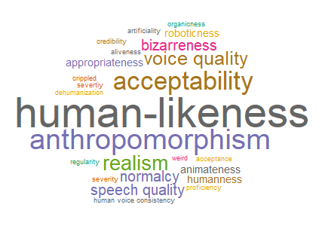
What is a natural voice? What is an unnatural voice?
…work in progress!
Notes:
- Getting a grasp of the verbal space we are dealing with

Slide 8
Finding a definition of voice naturalness – a challenging task
 | Categorical | Continous
Within human voices | Distorted vs. Typical/“normal“ | Degree of distortion/deviation
Beyond human voices | Human-likeness (Dichotomous) | Human-likeness (Degree)

Slide 9
(1) Human-likeness-based naturalness
(2) Deviation-based naturalness
Human-likeness i.e. resemblance to real human voice
Deviation from an exemplar/reference/ expectation/model that represents maximum naturalness
Conceptualization
„Does this voice sound like a real human speaker?“
Example definitions for participants or readers
“Does this voice sound distorted?”/ “Does this voice sound untypical/rare/
unexpected?”
Notes:
Mostly across human category, presuppose something beyond human voices (Category of human vs. Non-human, even though transition may be continous)
Mostly within human category, for both human and non-human voices (does not need explicit definition of any categories, but can)
-> its not about the empirical realization, it‘s about the underlying conceptual framework, 1 assumes any kind of category boundary, 2 does not
-> compared to distinct emotions vs. Dimensions
Assumptions can be empirically tested
1 can be seen as a special case of 2
Another advantage: they are intuitive and easy to understand
Beyond: manipulated, synthezised, artificial

Slide 10
(1) Human-likeness-based naturalness
(2) Deviation-based-naturalness
“referring to the level of naturalness and likeness to human voice“ (Li et al 2023)
"Speech naturalness can be described as how the speech of a person with a speech disorder compares with that of typical speech or, in the case of an acquired disorder, how an individual’s speech compares to its premorbid state“ (Anand & Stepp 2015)
“‘natural speech’’ is the speech most closely perceived as a human voice“ (Mawalim 2022)
“voices which sound like they could come from an actual human being (which should be rated as more natural) and voices that sound more fictitious, such as a cartoon character or a monster (which should be rated as less natural)“ (Kapolowicz et al , 2022)
"Naturalness is defined as the correct use of emphasis, intonation, pitch, intensity,
and pauses, according to the message and intention" “ (Cistola et al. 2021)
"perception of the degree to which speech meets the typical patterns in terms of intonation, voice quality, rate, rhythm, and intensity, with respect to the syntactic structure of the utterance“ (Atmaja et al. 2021)
“Humanness perception of technology is defined as the degree to which a user feels a certain technology or system is human-like (versus machine-like)“ (Hu & Lu, 2021)
"naturalness was defined as conforming to the listener’s standards of rate, rhythm, intonation, and stress patterning and to the syntactic structure of the utterance being produced” (Yorkston et al 1990)
"By naturalness, we understand the voice stimulus to be perceived as a plausible outcome of the human speech production system.“ (Nussbaum, et. al. 2023)

Slide 11
Literature Overview
84 studies (including reviews and meta-analyses)
Either measure naturalness perception
Or manipulated naturalness/human-likeness
Empirical perception studies (> 90%)
Databases
Automatic analyses
Tool development and validation
Reviews
Speech analyses
Eye Tracking, fNIRS, fMRI, EEG
23 provided a definition
43 human-likeness-based naturalness
32 deviation-based naturalness
9 both/mixture
…work in progress!
Notes:
-> definition is implict by the stimulus material used
Mixture: synthesized voice studies (e.g. vocoder and then they tweek parameters to understand their impact on voice perception)

Slide 12
Inconsistent operationalization

Slide 13
(1) Human-likeness-based naturalness
(2) Deviation-based naturalness
Manipulations/Variation:
Vocal categories
Acoustic manipulation
Vocal Categories:
Human voices (manipulated or unmanipulated)
Synthetic voices (TTS, articulatory synthesis, concatenative synthesis)
Measurement:
Ratings
forced-choice pairwise comparisons
…
Manipulations/Variation:
Vocal categories
Acoustic manipulation
Vocal Categories:
Distorted voices (parkinson’s disease, dysarthria, stuttering, electrolarynx speech, spinocerebellar ataxia, tracheoesophageal speech)
Dialects/Accents
Acted speech
Age
Masculinity/femininity; gender identities
Vocal fry
Measurement:
Ratings
forced-choice pairwise comparisons
…
Notes:
Reliability
Listeners: trained, experts, lay persons
Ratings: direct magnitude estimation (DME) and equal-appearing interval (EAI) scaling
Suitable scale to measure it
How is it explained to the

Slide 14
Challenges with operationalization
How naturalness is explained to the listener (what they should attend to)
Reliability of measurements
The
appropriate scale
The precise properties of the voice material
Potential
confounds
Insufficient report of empirical details
Notes:
Listeners: trained, experts, lay persons
Ratings: direct magnitude estimation (DME) and equal-appearing interval (EAI) scaling
Diverse operationalization would be amazing to compare effects across studies -> but thats not possible
Always… provide stimulus examples

Slide 15
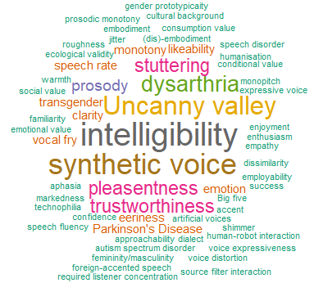
Related concepts
Notes:
Empirical focus of studies
Diverse field… which is not necessarily something bad
But it is a complete chaos
We lack a common ground regarding definition and operationalization

Slide 16
Lack of exchange between different research domains

Slide 17
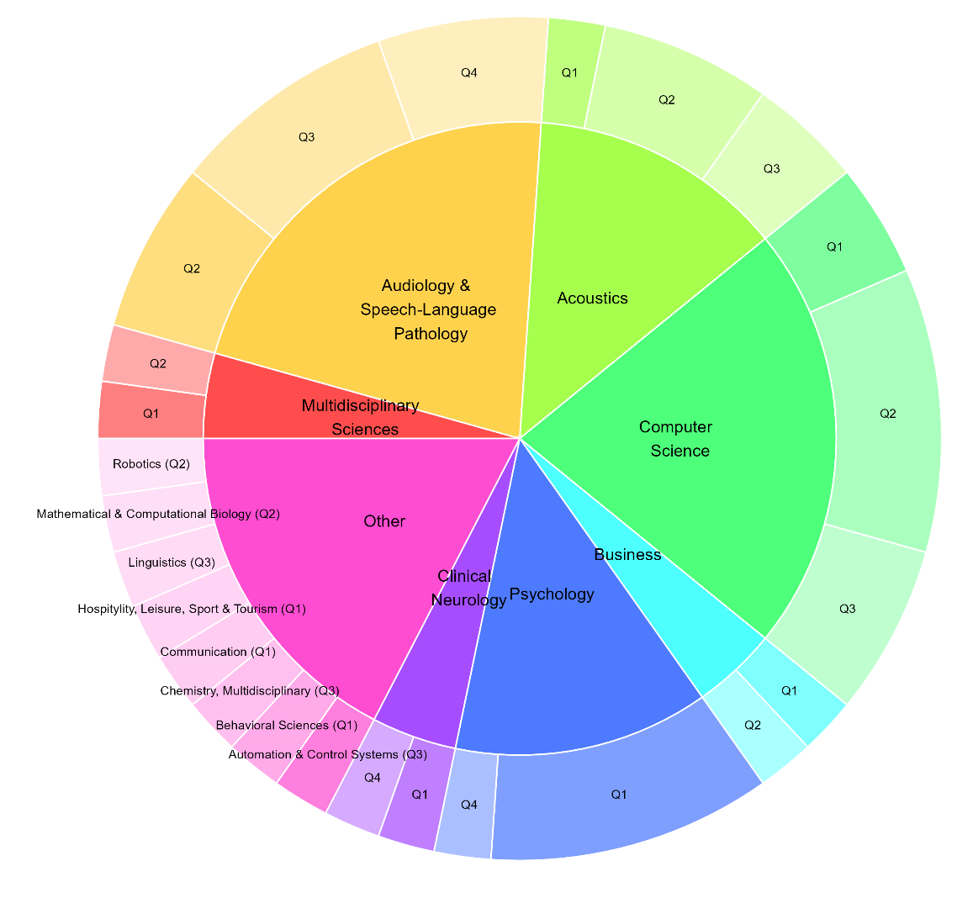
Notes:
N = 46
A really interdisciplinary field
Different interests
Different readership
Different publication culture
Different scientific standards
(biggest contribution is *not* coming from psychology)

Slide 18
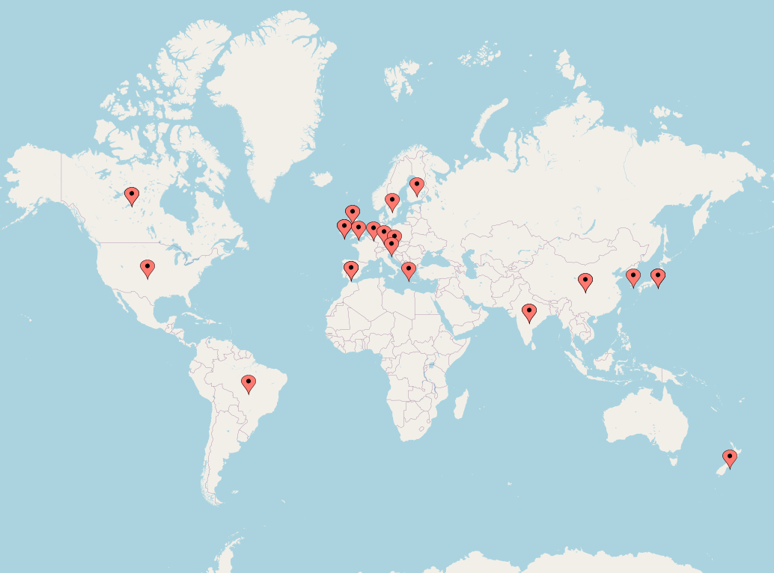
Notes:
29 from US
10 from Germany
6 from Japan
https://www.mapcustomizer.com/#

Slide 19
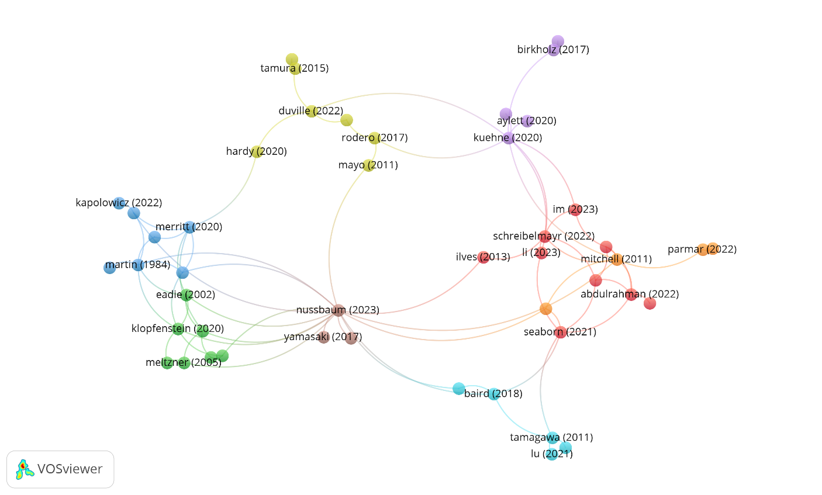
Naturalness - a rag rug rather than a research field
Notes:
N = 61 studies (of 84)

Slide 20
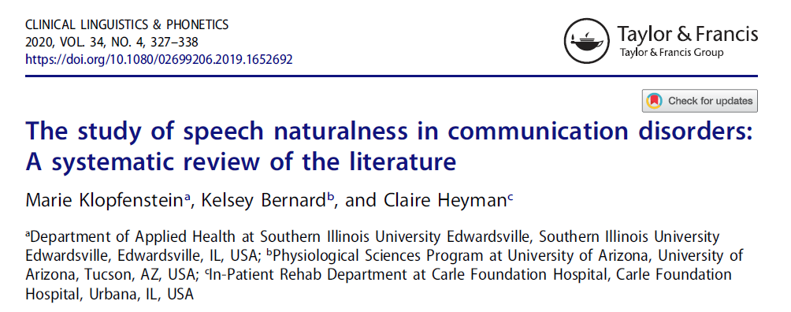
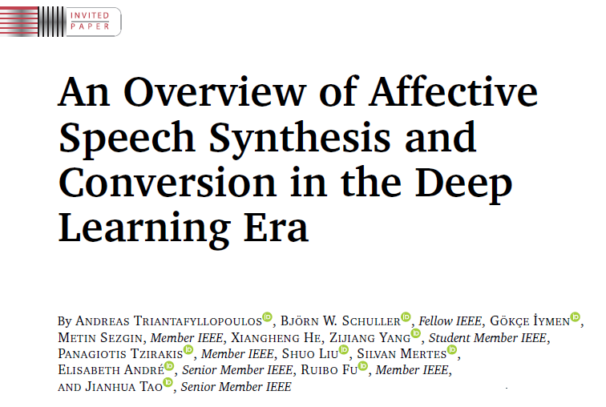
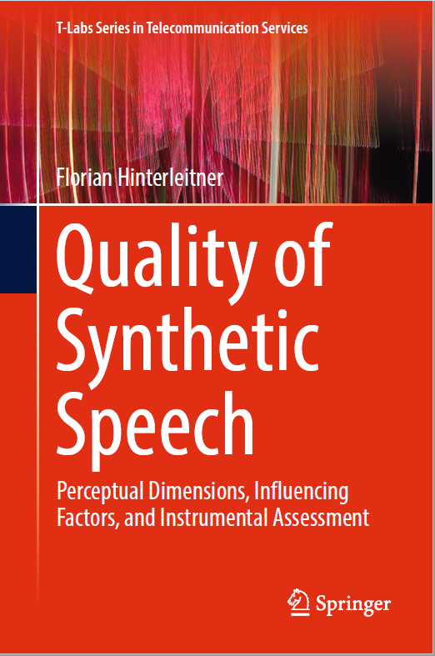
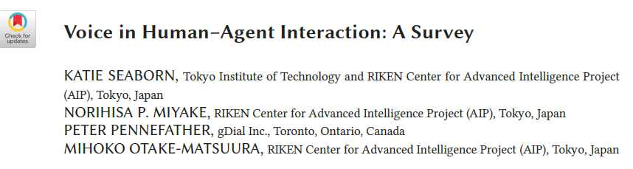
How about any integrative works?
2020
2023
2021
2017
Notes:
Domain specific, but raise good questions and identifiy gaps
Underspecification, reliability, lack of theory, inconsistent terminology
„need to address relationships between naturalness and other variables included in the studies. “

Slide 21
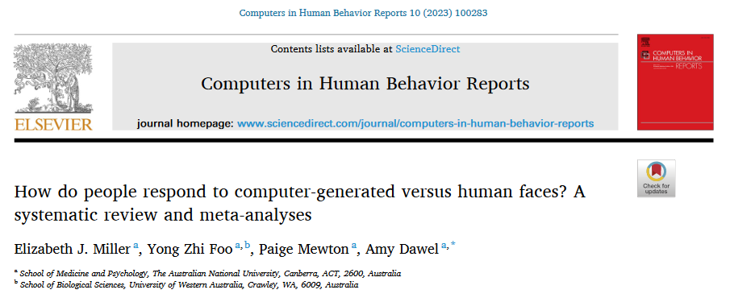
How about any integrative works?
2023

Slide 22
Insufficient anchoring in voice perception theory
Notes:
Main research is not coming from psychology

Slide 23
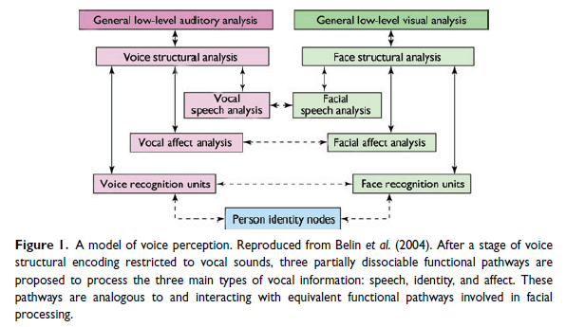
Understanding voice perception
Belin et al (2011)

Slide 24
Understanding voice perception
Are voices special?
Are human voices special?
Are natural voices special?
Are healthy voices special?
Notes:
Voices recruit networks/recourses in the brain that are not recruited by other tyes of acoustic stimuly
What happens, when they are no longer natural/human?
Trying to understand the impact of naturalness on perception is trying to understand what makes voices special

Slide 25
(1) Human-likeness-based naturalness
(2) Deviation-based-naturalness
Human-likeness i.e. resemblance to real human voice
Deviation from an exemplar/reference/ expectation/model that represents maximum naturalness
Conceptualization
Is the perception between human and non-human voices categorical?
Do similar rules/patterns apply to naturalness variation within human voices compared to human/non-human voices?
How does naturalness affect the processing in the brain?
Which role does experience play? / adaptability
Does reduced naturalness due to stimulus manipulation have implications for ecological validity?
Notes:
The reseach questions: do similar regulations/rules/patterns apply to naturalness varition within human voices compared to human/non-human voices
Is human voice/ nonhuman-voice inherently categorical or is this a spectrum?
How to define a non-human voice?
Empirically disentangle the effect of catory vs. the effect of deviation

Slide 26
Interim summary:
Conceptual underspecification
Inconsistent operationalization
Lack of exchange between different research domains
Insufficient anchoring in voice perception theory
Precluded a systematic understanding of vocal naturalness
Impeded the visibility of this research to a wider readership
Has kept us from asking some crucial research questions
Has led to a divergence between theory and practise
Notes:
My Mission: naturalness as a voice features that we systematically understand

Slide 27
What we know about voice naturalness so far…

Slide 28
"The findings imply that VAs should not be designed to closely resemble humans.
Rather, consideration of usage contexts and consumer expectations should be prioritized in developing most
likable VAs.“ (Im 2023)
Is naturalness always better? – not necessarily
rated as more likeable, trustworthy, intelligible, pleasent (Kühne et al., 2020)
no interaction with attitudes towards robots (Kühne et al., 2020)
for service robots in restaurants, humanlike voice is the most important factor for consumption outcomes (compares to visual or verbal cues) (Lu et al., 2021)
human voices more effective for advertisement stories and audiobooks (Rodero et al, 2017, 2023)
human and synthetic (TTS) voices similar rated in likeability, co-presence and trust (Abdulrahman & Richards, 2022)
no effect on lexical decisions (Burton & Blumenstein, 1995)
synthetic voice preferred for functional tasks, no difference for social task (Im, 2023)
human-like voices overall preferred, but even more for social tasks (Schreibelmeyer et al., 2022)
Interindividual differences between listeners (Hu, 2021)

Slide 29
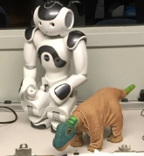
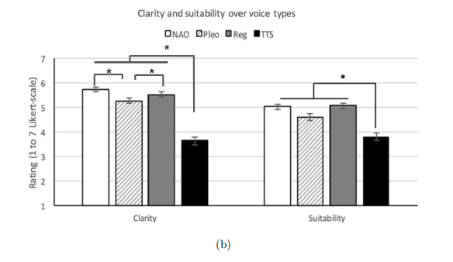
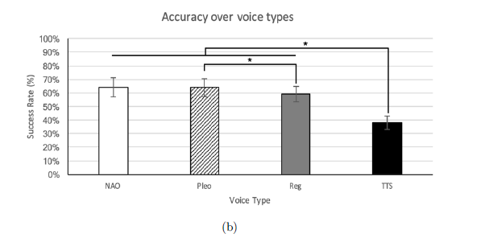
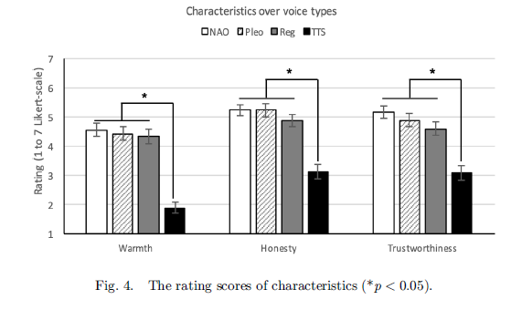
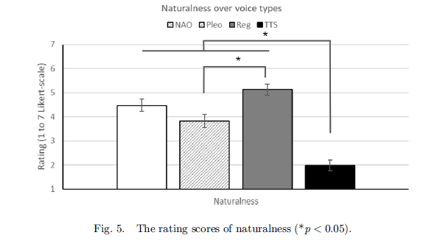
Ko et al. (2023)
Notes:
- cartoon voices
- voice caricature (less natural, but more emotionally expressive)

Slide 30
Acoustic correlated of naturalness
„monopitch“ (Anand & Stepp 2015)
F0 variance (Baird et al 2018)
Formant frequencies (Hardy 2020)
F0-FF co-variation (Assmann 2006)
Jitter and shimmer (Yamasaki et al 2017)
Vocal fry - depending on listener group (Chappell et al 2020)
Spectral envelope (Kapolowicz et al. 2022)
Fluency (Mackes et al. 1997)
Artifacts and discontinuities (Mayo et al. 2011)
Breathing patterns/pausing (Kühne et al. 2020, Ratcliff et al. 2002)
Spectral ripples, spectral tilts, bandpass filtering (Moore et al 2003)
Notes:
Moore: „distortions were meant to mimisc transducers such as microphones, loudspeakers and earphones “

Slide 31
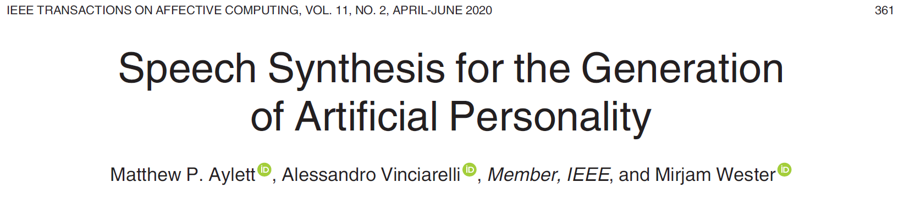
Links between naturalness and other voice characteristics
Voice distortions and pathologies
Not correlated with Big-Five, except openness (Aylett et al 2020)
Linked to age and (trans-)gender perception (Baird et al. 2017, 2018, Coughlin-Woods et al. 2005, Merritt et al. 2020)
Speech accent (Kapolowicz et al. 2022, Tamagawa et al. 2011)
Notes:
Androgenous voice less natural, synthesized voices do not necessarily need to fall into one of the two gender categories
Increases during childhood

Slide 32
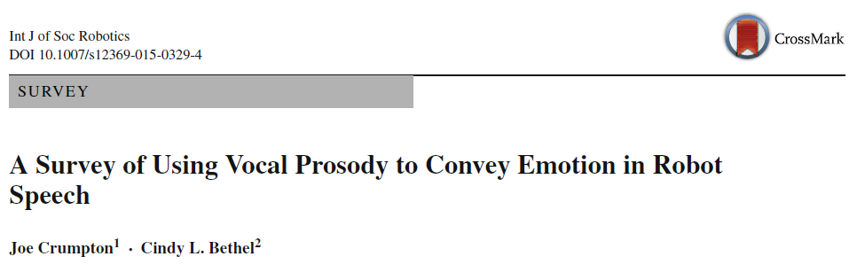
Naturalness and emotionality…. An ongoing mystery…
Human voices rated as more expressive compared to synthesized ones (Cabral 2017)
Emotions expressed by ASD participants were better recognized, while rated as being less natural (Hubbard et al. 2017)
Unnatural voice prosody interacts with the perception of emotional semantic content (Ilves et al. 2011, 2013)
Emotion recognition in cartoon voices better, but in TTS worse (Ko et al. 2023)
Perceived naturalness affect emotion recognition but not valence/arousal ratings (Duville et al, 2022; Nussbaum et al. 2023)
„The communication of emotions through changes in vocal prosody is one way to make synthesized speech sound more natural.”

Slide 33
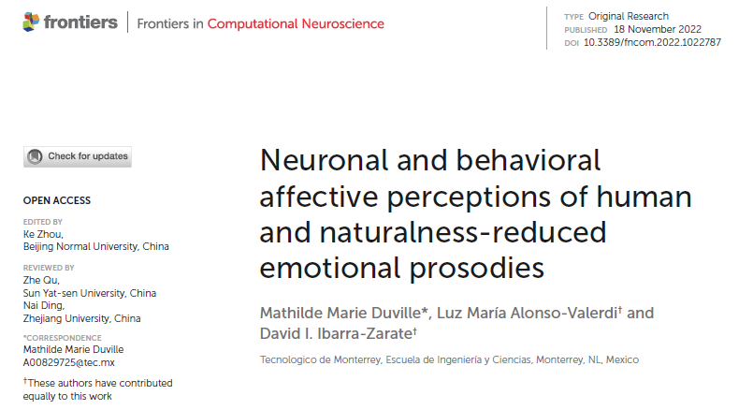
Duville et al . (2022)

Slide 34
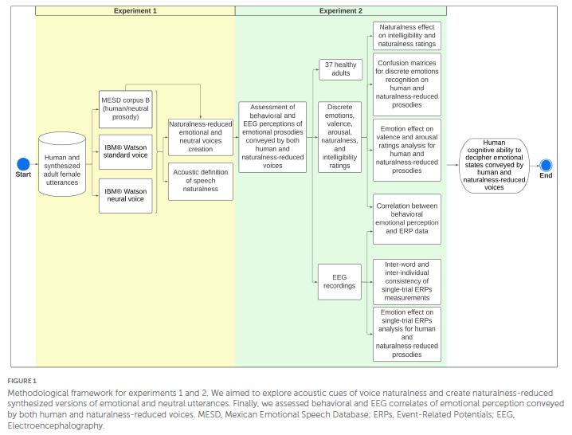
Duville et al . (2022)
Human
Level 1
Level 2
Notes:
- pitch contour, formants, harmonics,

Slide 35
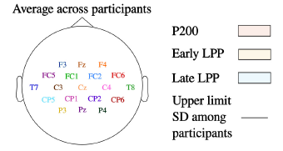
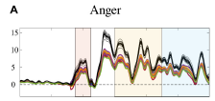
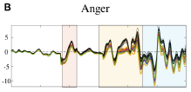
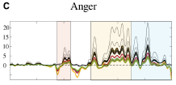
Duville et al . (2022)
Human
Level 1
Naturalness affects the P200 and the LPP (less sensitive to emotional differentiation at lower naturalness)
Remotion recognition reduced
Valence and arousal perception peserved
Level 2
Notes:
- pitch contour, formants, harmonics,

Slide 36
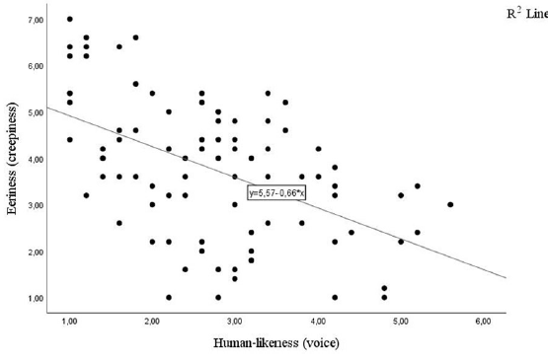
The uncanny valley for voices
No consistent evidence for an uncanny valley for voices
Evidence for a linear relationship between naturalness and perception of eeriness/trust (Alipour 2023, Kühne 2020, Baird et al 2018, Romportl 2014, Schreibelmayer 2022)
Kühne et al 2020
Notes:
Alipour 2023, Kühne 2020, Baird et al 2018, Romportl (2014), Schreibelmayer (2022)
- proposed in 1970 for visual appearence
- evidence more than conflicting
- one of these persevering concepts in the literature that always get sooo much attention

Slide 37
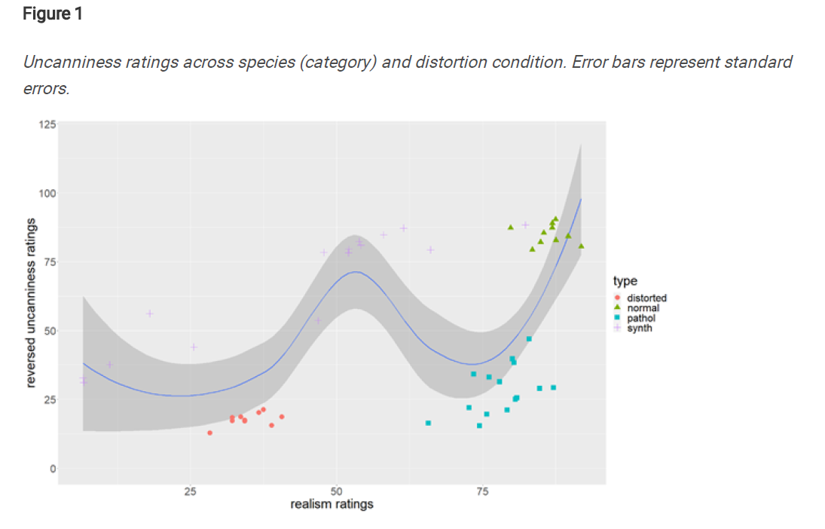
Diel & Lewis (2023 – preprint)
(1) Deviation from familiar categories
(2) Categorical ambiguity

Slide 38
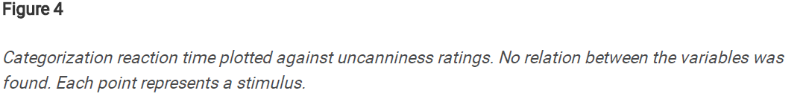
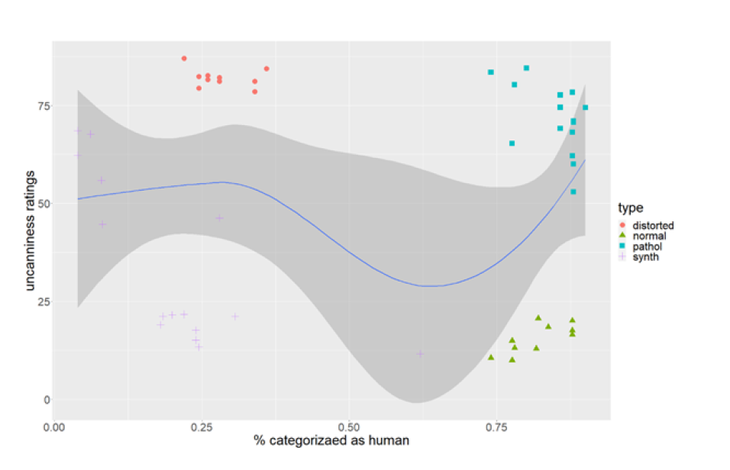
Diel & Lewis (2023 – preprint)
“While voices can fall into an uncanny valley, synthetic voices successfully escape it. The results support the account that uncanniness is caused by deviations from familiar categories, rather than categorical ambiguity or the misattribution of mind or animacy.”
Notes:
Pool data across categories

Slide 39
Multimodal agent perception
No effects of voice naturalness on judgement of virtual character (Cabral et al. 2017)
"higher motion and voice realism independently improve speech-gesture match, as well as perceived likability and human-likeness; maximum naturalness in each channel should be preferred over congruence between modalitites“ (Festl et. al., 2021)
negative effects of inconsistency (Gong et al., 2007)
Notes:
Does audiovisual mismatch affect agent perception negatively?
Alipour 2023

Slide 40
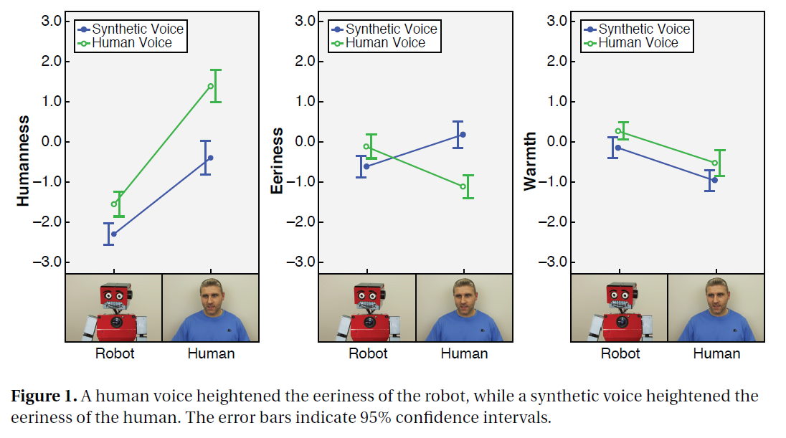
Multimodal agent perception (Mitchell 2011)

Slide 41
Thank you for your attention ☺

Slide 42
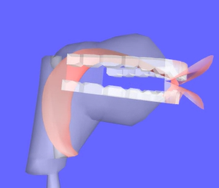
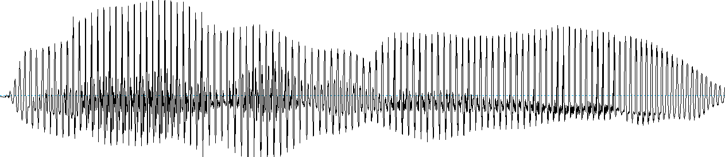
Overview over voice synthesis methods
Concatenative synthesis
Articulatory synthesis
Statistical parametric speech synthesis
Hidden Markov Models
+
Deep Learning Methods
Text-to-Speech (TTS)
https://www.vocaltractlab.de/
https://www.ibm.com/products/text-to-speech
Notes:
Articulatory synthesis: models for the movement of lips, tongue, glottis, and vocal tract
Concatenative synthesis: where the target utterance is constructed from a set of prerecorded building blocks: words, syllables, half-syllables, phonemes, diphones, or triphones
Statistical parametric synthesis: a machine/network is trained on speech data and this information is then fed to a vocoder

Slide 43
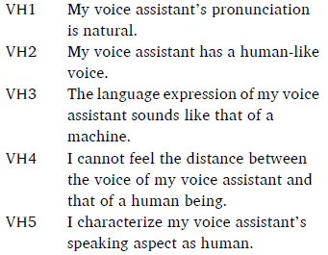
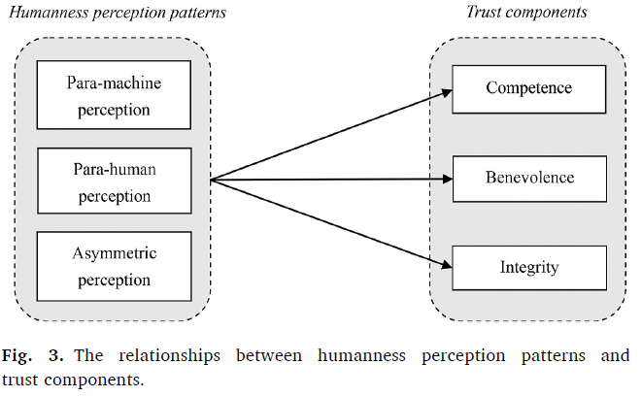
Interindividual differences (Hu, 2021)
Dual humanness:
voice humanness perception reflecting perceived humanness
understanding humanness concerning the listening aspect
“Surprisingly,we do not find a perception pattern exhibiting moderate evaluation on voice humanness and understanding humanness. The absence of this profile suggests that perceived humanness may not be a continuum, but rather be dichotomous, in users’ mind.listening aspect of conversation AI.” (p. 11)
Notes:
Third, for users who have a para-machine perception regarding conversational AI, their levels of trust in conversational AI are surprisingly not the lowest among the discovered perception patterns. Instead, users who possess an asymmetric perception pattern show the lowest morality-based trust. This finding suggests that the asymmetry between humanness perceptions on the speaking and listening of conversational AI may leads users to question the ethics of their conversational AIs.
Kuriki 2016: people without ASD: difference in naturalness, with ASD: none (robot affinity)
Lee (2010): naturalness-effect only for intuitive and less analytical participants (played a game with a robot)
Schreibelmayer (2022): listeners openness affects human-likeness preference

Slide 44
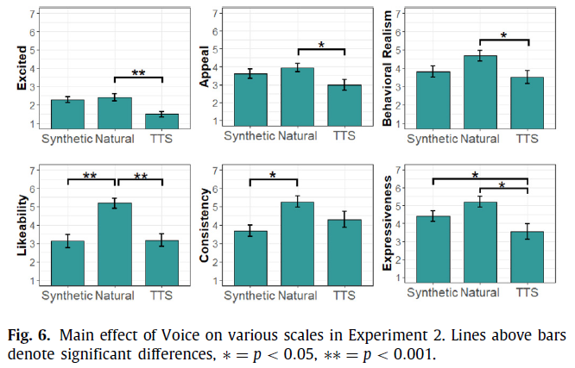
Higgins et al. (2022)
Notes:
- smoothing of pitch cues via Tandem-STRAIGHT, they manipulated naturalness of human recordings, but not manipulation check

Slide 45
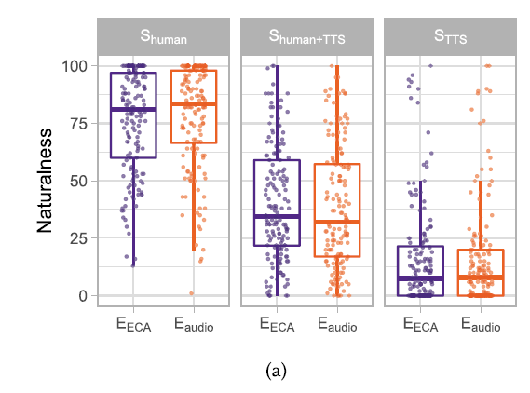
Ehret et al. (2021)
Notes:
"(1) inadequate prosody, as generated by off-the-shelf text-to-speech (TTS) engines with synthetic output; (2) the same inadequate prosody imitated by trained human speakers; and (3) adequate prosody produced by those speakers"

Slide 46
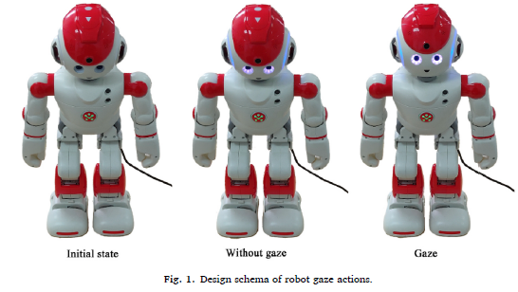
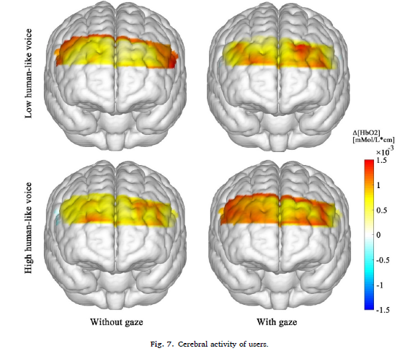
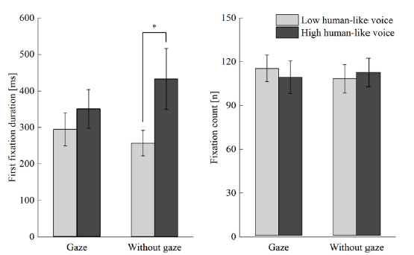
Brain data (Li et al 2023)
Notes:
Congruency effect

Slide 47
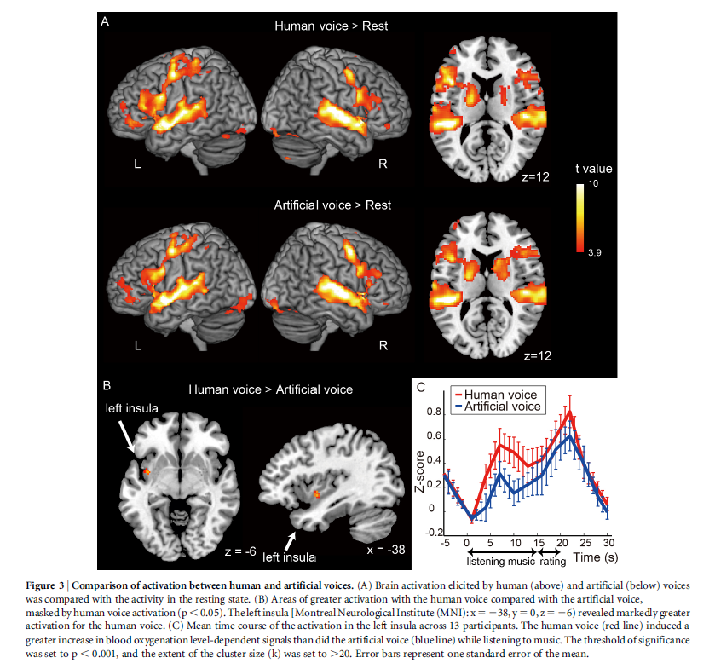
Brain data (Tamura et al 2015)
Notes:
MRI: significantly higher activation in the left posterior insula in response to human voices than in response to artificial voices
Singing voices

Slide 48
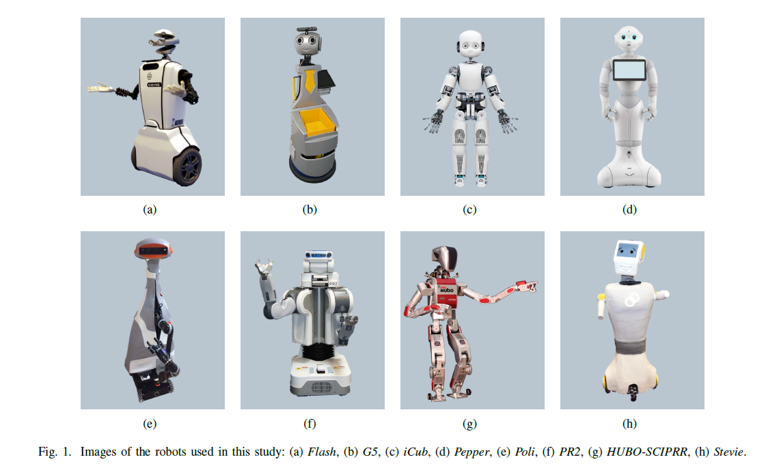
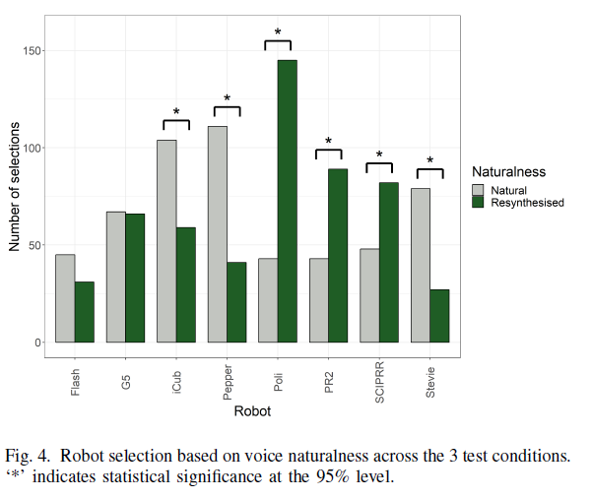
Multimodal agent perception (McGinn and Torre 2019)
Notes:
- People match human-like voices with more human-like robots

Slide 49
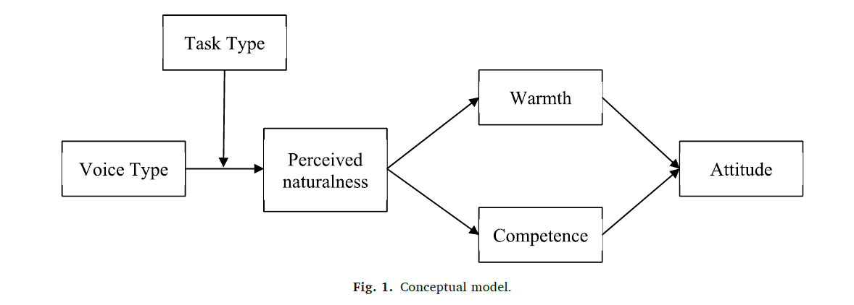
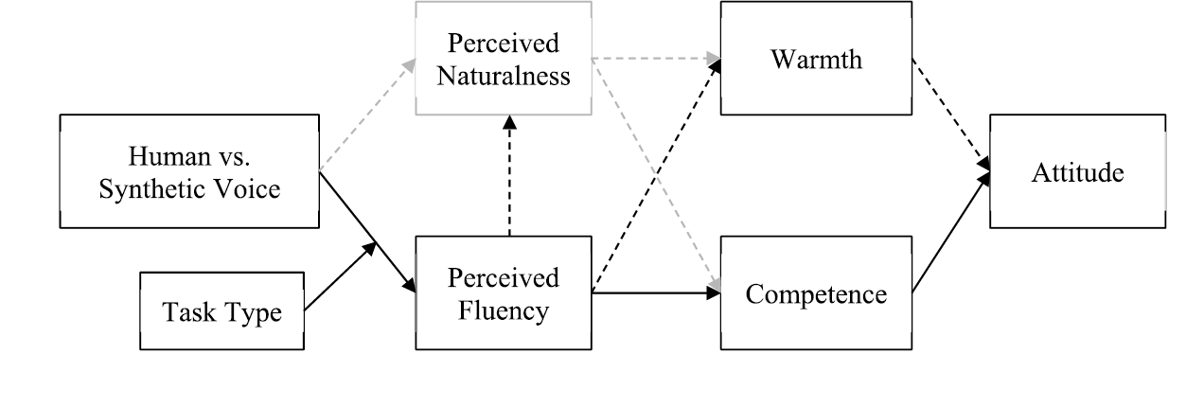
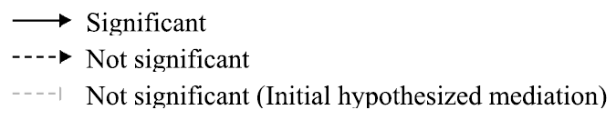

Is naturalness always better? – not necessarily (Im 2023)
"The findings imply that VAs should not be designed to closely resemble humans.
Rather, consideration of usage contexts and consumer expectations should be prioritized in developing most
likable VAs.“ (Im 2023)
Notes:
Baird 2018: linked to likeability
"The findings imply that VAs should not be designed to closely resemble humans.
Rather, consideration of usage contexts and consumer expectations should be prioritized in developing most
likable VAs.“ (Im, 2023)

